Slide 1




NEXT GEN EMPLOYABILITY PROGRAM
Creating a future-ready workforce
Team Members
College Name
Student Name :ROHITH MALAR.A.K
Student ID :au711021205018
INFO INSTITUTE OF ENGINEERING.

Slide 2

CAPSTONE PROJECT SHOWCASE
Project Title
Notes Sharing Web Application using Django Framework
Abstract | Problem Statement | Project Overview | Proposed Solution | Technology Used | Modelling & Results | Conclusion

Slide 3
Abstract
This abstract presents the development of a note-sharing web application using the Django framework, highlighting its architecture, features, and benefits.
The note-sharing web application built on Django offers a user-friendly interface for creating, managing, and sharing notes seamlessly. Leveraging Django's Model-View-Template (MVT) architecture, the application separates data models, business logic, and presentation layers, ensuring code modularity and maintainability.
Users of the application can register, log in, and personalize their profiles, enabling a personalized experience tailored to their preferences. Django's built-in authentication system ensures secure user access and permission management, safeguarding sensitive information within the platform.
Source :
https://github.com/Rohith83/full-stack-web-development-naan-mudhalvan.git

Slide 4
Problem Statement
The primary goal of this project is to develop a note-sharing web application that enables users to create, organize, and share notes seamlessly. The application will address the following key challenges and requirements:
Inefficient Note Management:
Users currently rely on disparate methods for managing notes, leading to disorganization and difficulty in locating relevant information.
Tedious Sharing Processes:
Current methods of sharing notes, such as email attachments or physical distribution, are time-consuming and prone to errors.
Limited Collaboration Features:
Existing note-taking applications often lack robust collaboration features, such as real-time editing, comments, and version history tracking.
Source :
https://github.com/Rohith83/full-stack-web-development-naan-mudhalvan.git

Slide 5
Project Overview
The Note Sharing Web Application aims to provide users with a platform to create, organize, and share notes seamlessly. Built using the Django framework, this project emphasizes simplicity, efficiency, and collaboration.
1.User Authentication and Authorization
2.Note Management and note sharing
3.Collaboration Features
Source :
https://github.com/Rohith83/full-stack-web-development-naan-mudhalvan.git

Slide 6
Proposed Solution
Search and Filter Functionality:
Filtering options will enable users to narrow down search results by criteria such as date created, author, or category.
Responsive Design:
The application will be designed to be responsive and accessible across devices of various screen sizes, including desktops, tablets, and smartphones.
Database Design:
Design the database schema to store user profiles, notes, sharing permissions, and other relevant data.
Choose an appropriate database backend supported by Django, such as PostgreSQL or MySQL.
Source :
https://github.com/Rohith83/full-stack-web-development-naan-mudhalvan.git

Slide 7
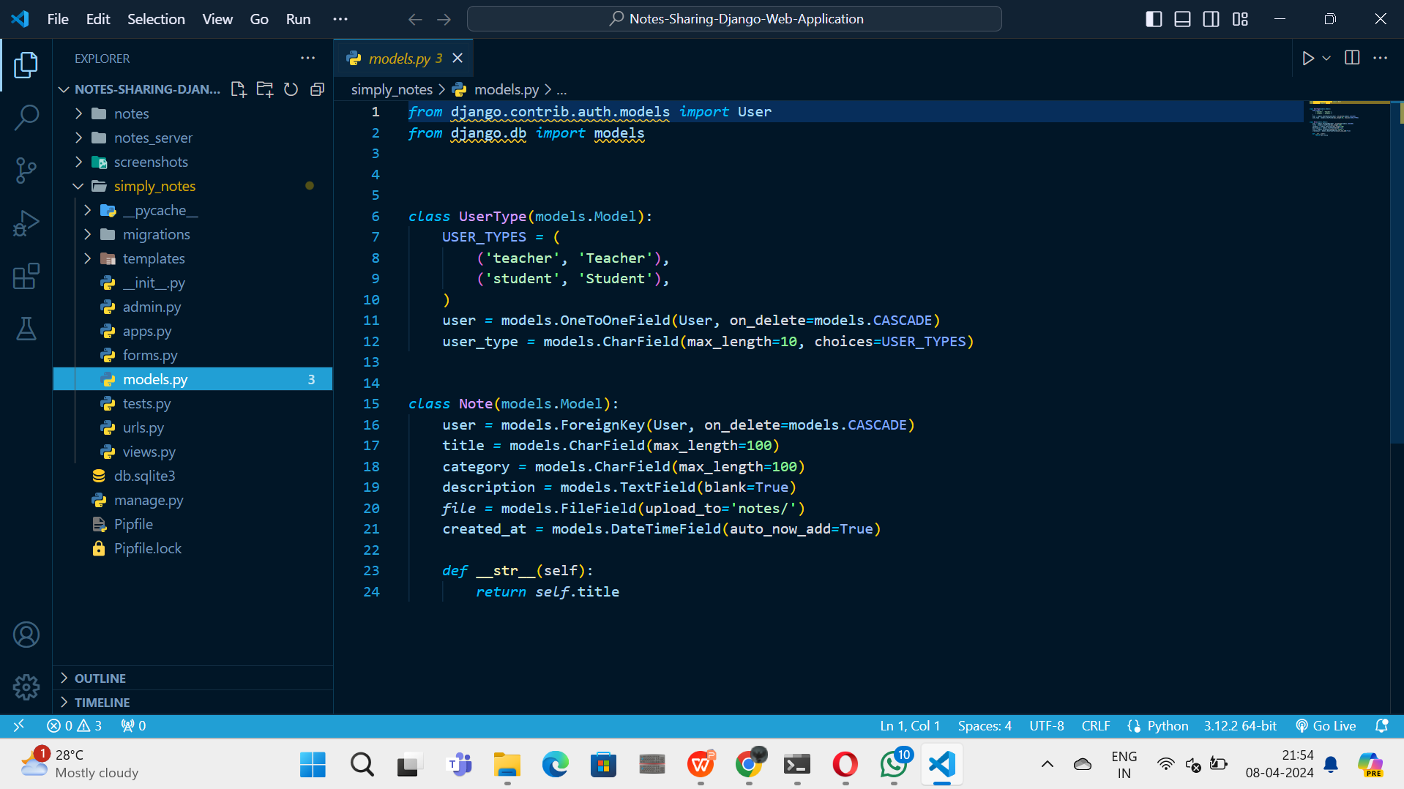
Source :

Slide 8
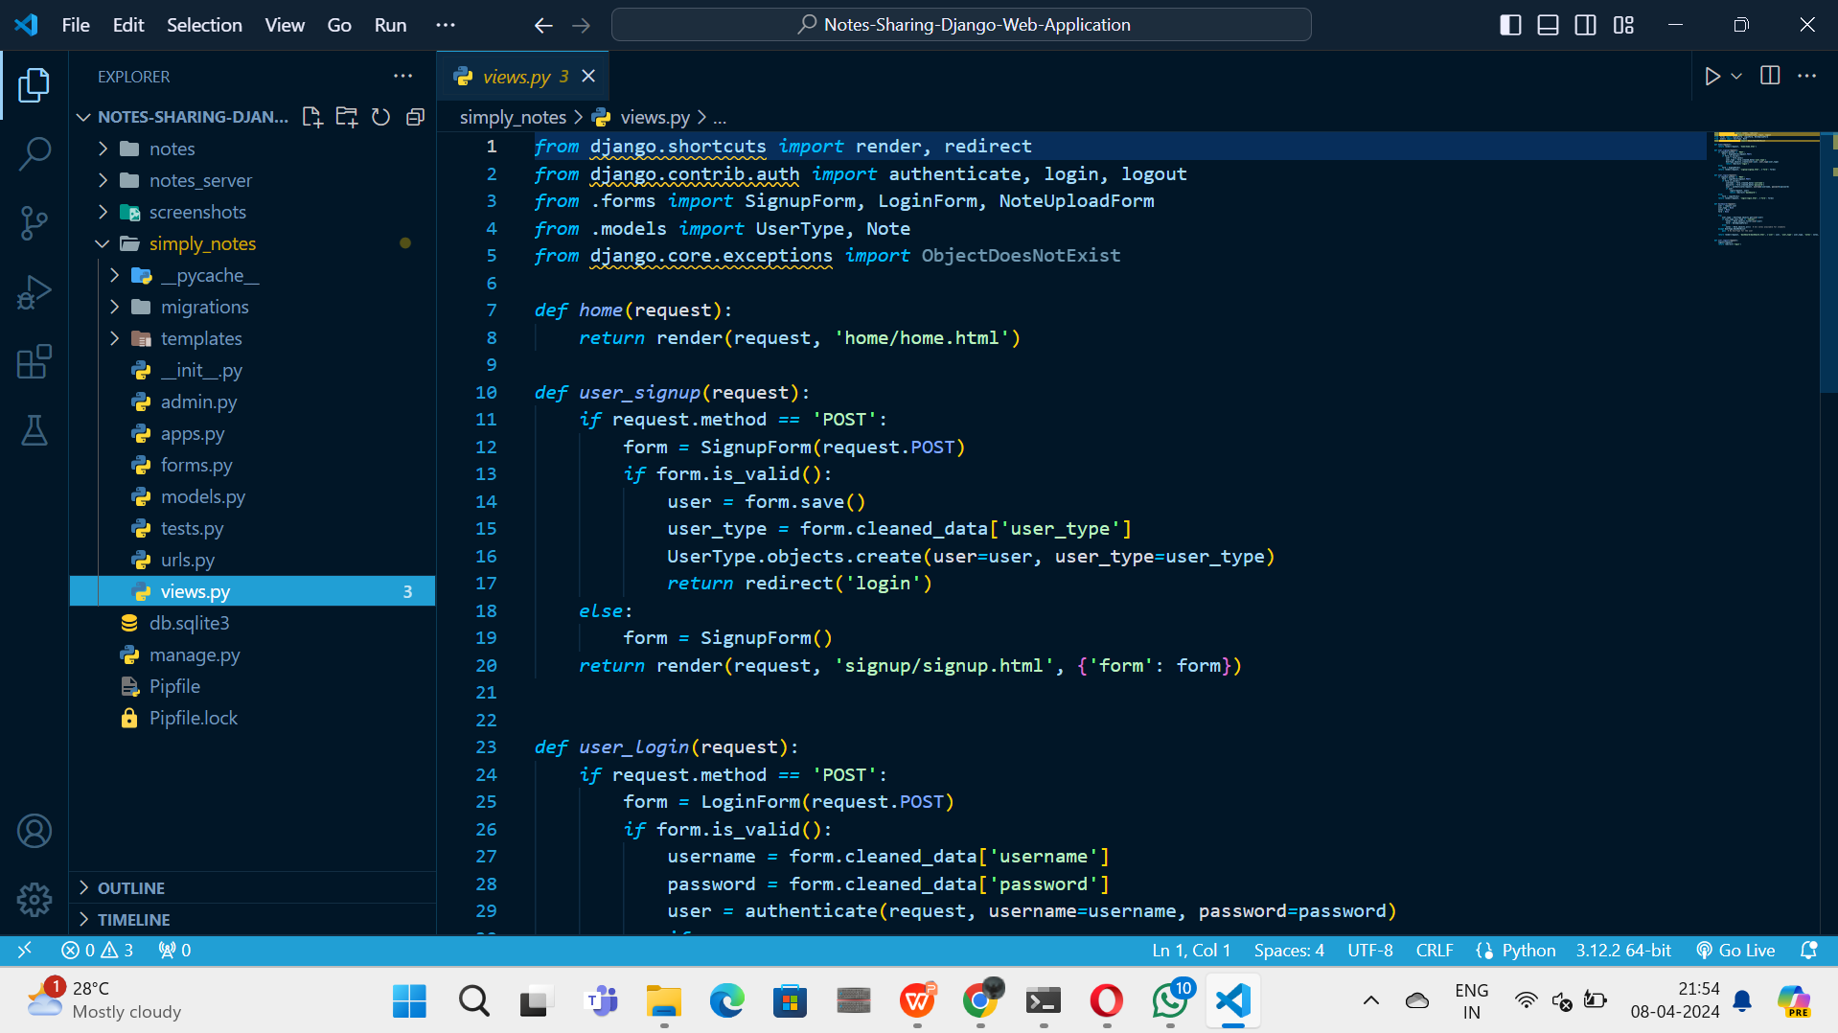
Source :

Slide 9


Technology Used
Front-end
Back-end
Source :
https://github.com/Rohith83/full-stack-web-development-naan-mudhalvan.git

Slide 10
Modelling & Results
This setup facilitates seamless note sharing and collaboration among users within the application. Users can create their own notes, share them with specific individuals, and view notes shared with them by others. The data model ensures that each note maintains its integrity and ownership while enabling collaborative interactions between users. Additionally, proper user authentication and authorization mechanisms are implemented to safeguard user data and ensure secure access to shared notes.
Source :
https://github.com/Rohith83/full-stack-web-development-naan-mudhalvan.git

Slide 11
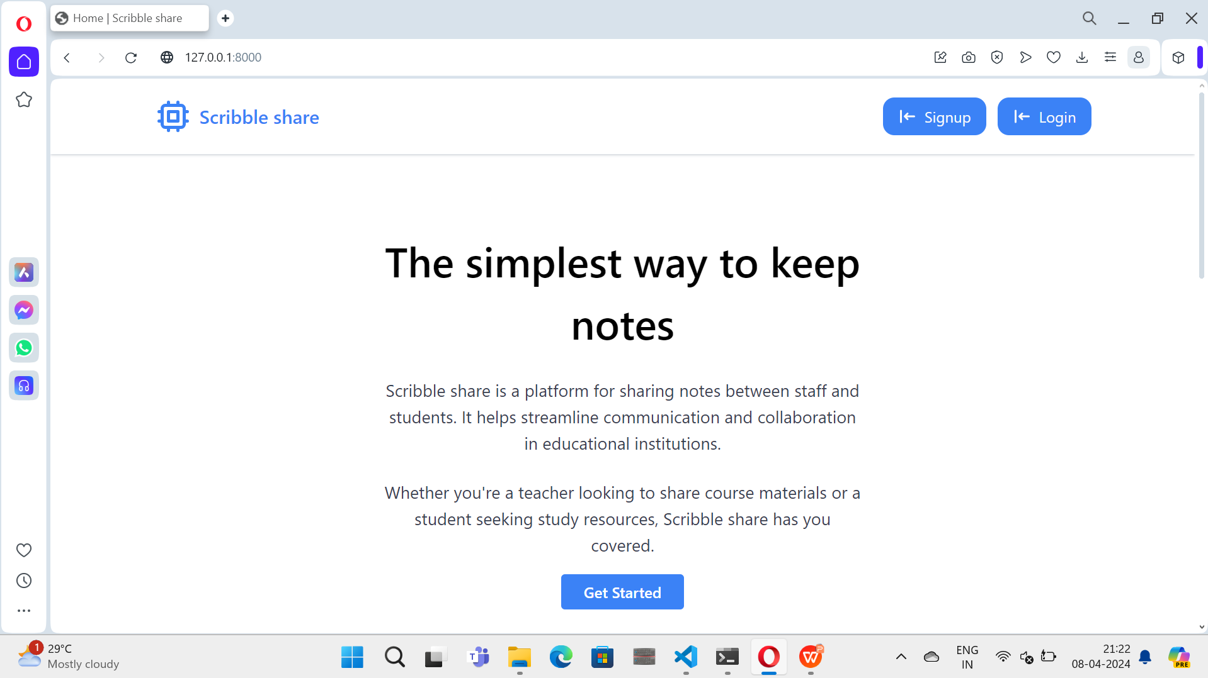
Homepage

Slide 12
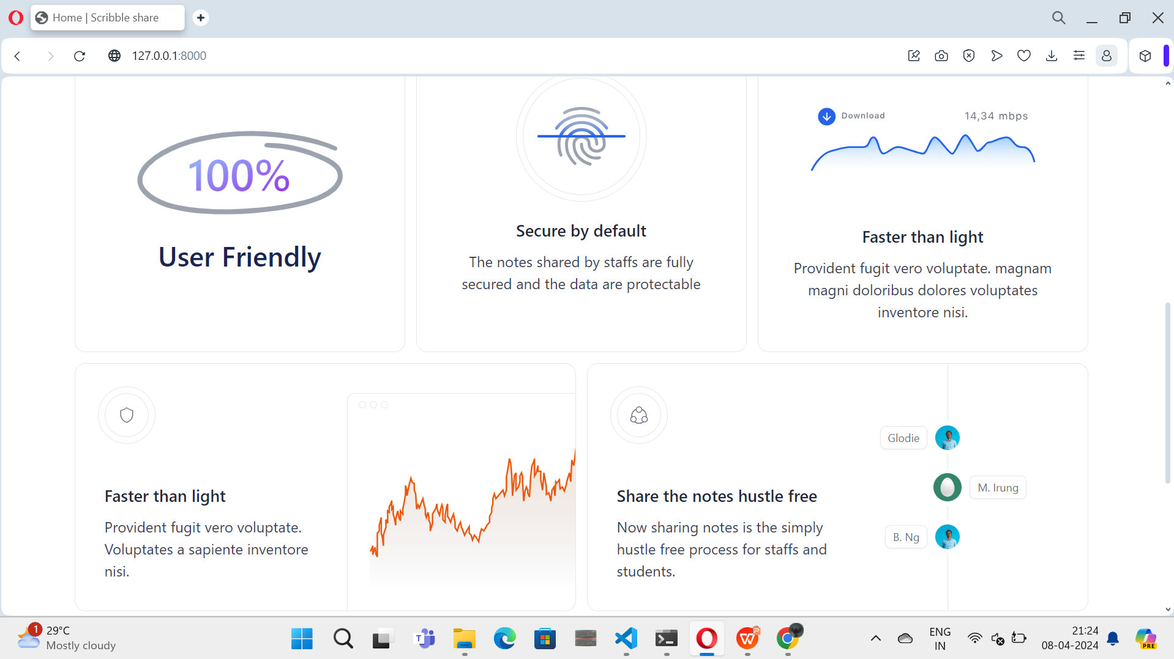
About-Us-Page

Slide 13
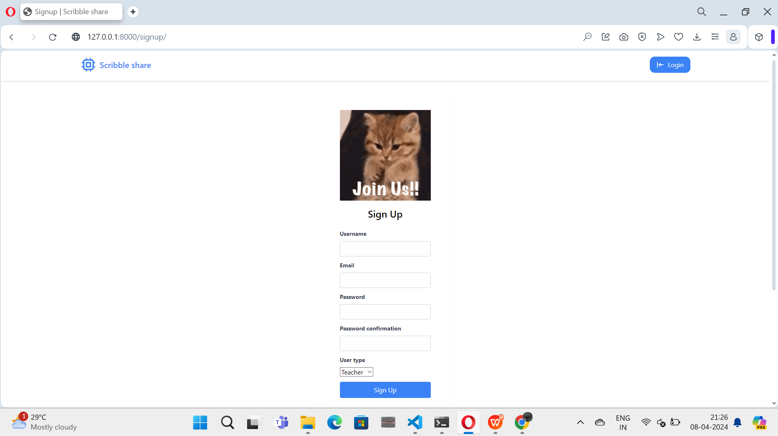
Signup

Slide 14
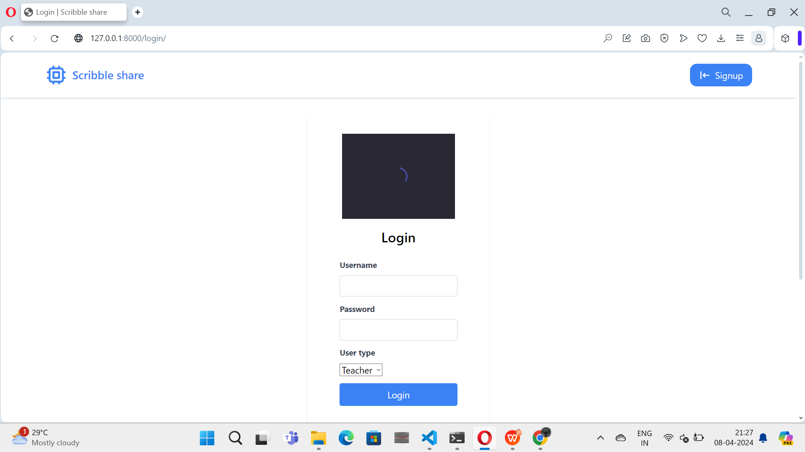
login

Slide 15
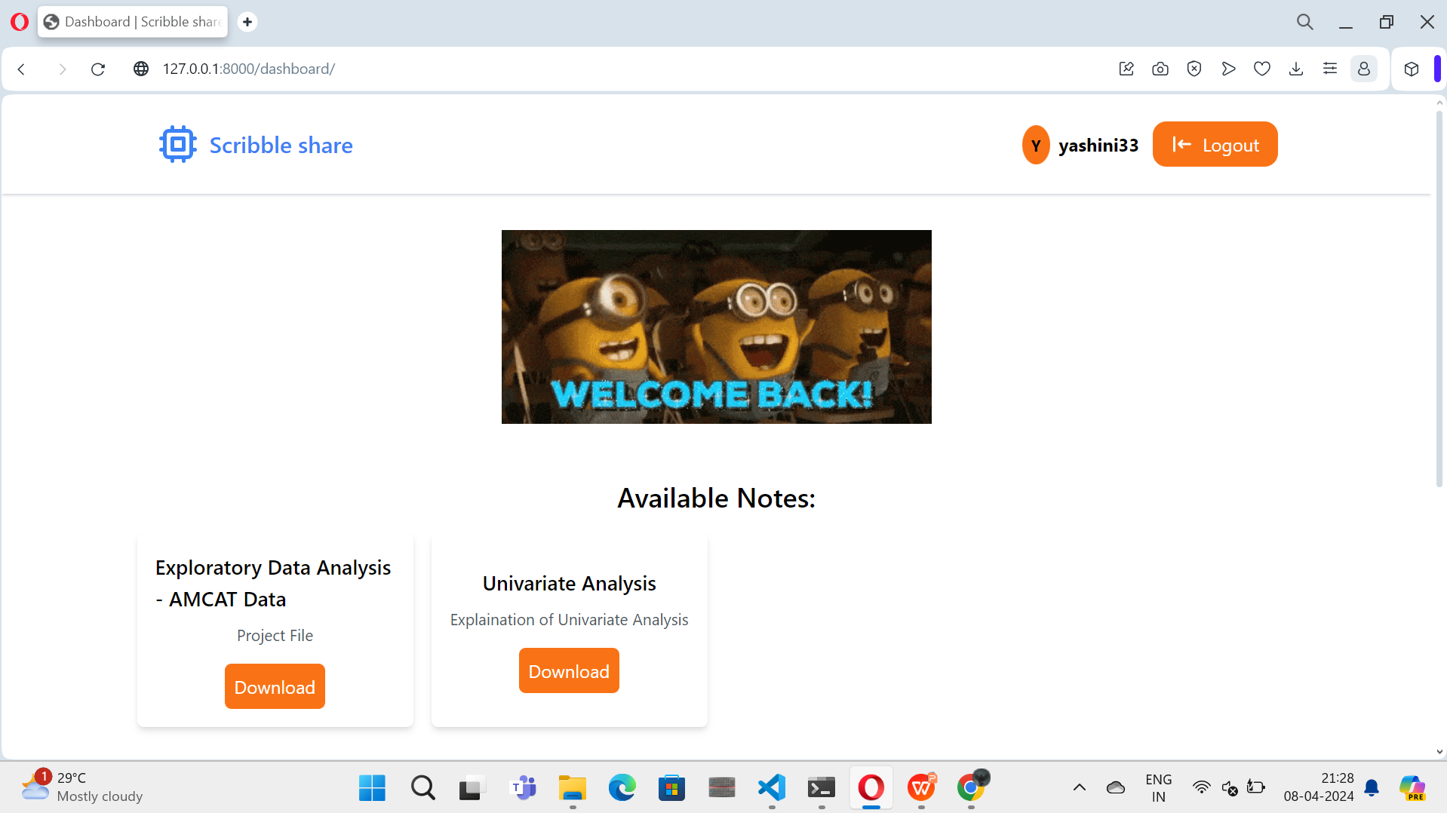

Slide 16
Future Enhancements:
Mobile Application Integration:
Advanced Collaboration Features
Integration with External Services:
Enhanced Security Measures:
AI-Powered Features:

Slide 17
Conclusion
The development of a note-sharing web application using the Django framework aims to address the challenges associated with traditional note-sharing methods by providing a centralized, secure, and collaborative platform for managing and sharing notes. By achieving the outlined objectives, the application will empower users to enhance productivity, streamline collaboration, and facilitate knowledge sharing in various contexts.
Source :
https://github.com/Rohith83/full-stack-web-development-naan-mudhalvan.git

Slide 18
Thank You!
Notes:
Thank You !!

